Slide 1


Slide 2


Team Details
Selected Track - Open Innovation Hardware
1
Project Name - SignWave - Gestures Speak Volumes
2
Team Name - The CodeFather
3
Team Lead - Danish Ahmed
4
5
Institute Name - Muffakham Jah College of Engineering and
Technology

Slide 3
Describe Your Idea or Project
Real-Time Sign Language Translation System
The project focuses on building a real-time sign language recognition system to facilitate communication for individuals who are deaf and/or mute.
The system employs a pair of gloves equipped with sensors to capture finger and thumb movements and to track hand orientation and motion. This data is sent wirelessly to an Android app, where it is processed using a machine learning model.
The model recognises the gesture based on the movement patterns. Once classified, the system converts the gestures into text and then audio output using a Text-to-Speech engine, enabling seamless communication.
Key Features:
Low-Cost Hardware
Energy Efficient
Real-Time Operation
Expandable Gesture Set
Cloud Integration
Multi-Lingual Support

Slide 4
Describe the Technology Stack Required:
Machine Learning Model Type:
Static Gestures: Decision Trees, Random Forest, SVM.
Dynamic Gestures: LSTM, RNN for time-series data.
Frameworks: Scikit-learn, TensorFlow/Keras for training and inference.
Mobile Application:
Platform: Android (Java/Kotlin/Flutter).
Communication: Bluetooth/Wi-Fi for real-time sensor data transmission.
User Interface: Display recognized gestures and output them as text and speech.
Text-to-Speech (TTS):
Google TTS API or Android Speech-to-Text for translating text output into spoken language.
Cloud Integration:
AWS EC2: Offloading computation-heavy tasks and providing cloud-based machine learning inference.
AWS S3: Storing models and datasets.
Online Learning (for Gesture Expansion):
Incremental Learning Algorithms: Incremental updates to the model as new gestures are added by the user using libraries like creme and river.

Slide 5
Describe your use cases
Real-Time Communication for Deaf/Mute Individuals
Allows seamless communication by converting sign language gestures into spoken words.
Sign Language Education
Assists learners by providing feedback on gestures, helping them practice and improve their skills.
Gesture-Based Control for Assistive Devices
Enables people with limited mobility to control smart devices (e.g., lights, TV) using sign language gestures.
Adding New Gestures Through Online Learning
Users can add new gestures to the system, and the model adapts through real-time learning.
Speech Therapy and Rehabilitation
Provides rehabilitation for speech-impaired individuals, using sign language as an alternative communication method.
Multilingual Sign Language Support
Supports multiple sign language variants, allowing cross-language communication.
Accessible Customer Support and Public Interfaces
Enables businesses and public service kiosks to interact with deaf/mute individuals using sign language.

Slide 6
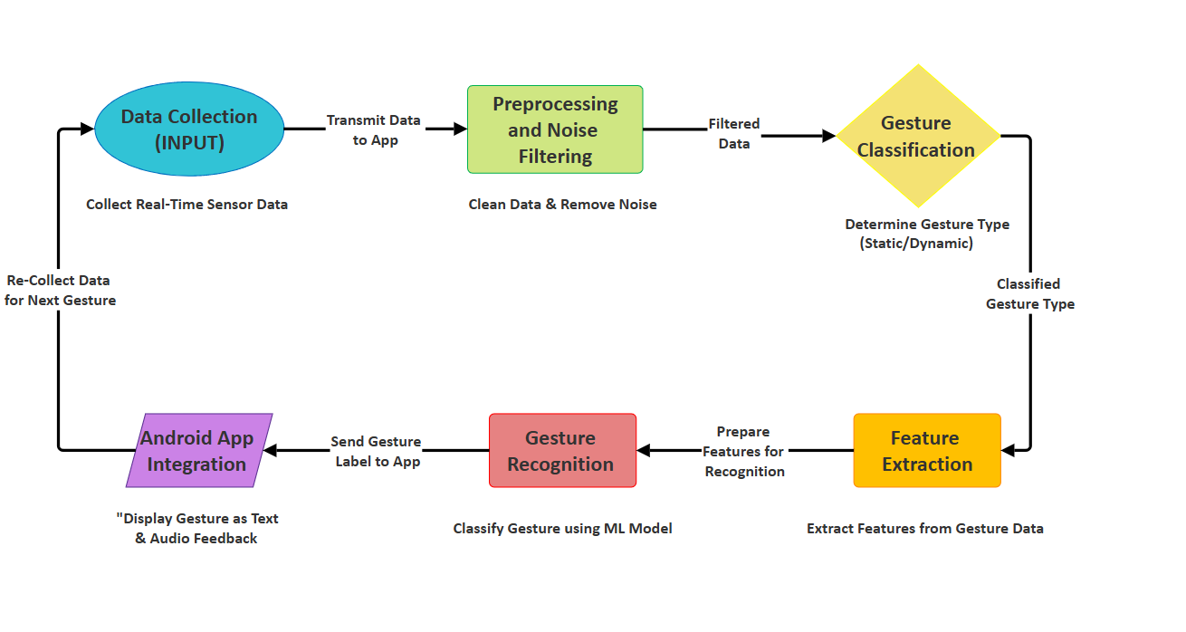
Block Diagram

Slide 7
List of Hardware Components
Flex Sensors (10 total): Measure the degree of bending for each finger and thumb to detect static gestures.
MPU6050 Sensors (2 total): Track hand orientation and dynamic motion using gyroscope and accelerometer data.
Microcontroller (ESP32): Collects sensor data, processes it, and transmits it via Bluetooth/Wi-Fi.
Rechargeable Li-ion Battery: Powers the system for portable and wireless operation.
Battery Charger Module: Allows safe recharging of the Li-ion battery without removing it from the system.
Gloves (A Pair): Wearable platform for mounting sensors and providing gesture input.
Resistors: Ensure proper electrical connections and stable operation of the sensors.
Connecting Wires: Facilitate assembly and connection of electronic components.
Enclosure/Case: Protects the electronic components and provides a compact, user-friendly design.

Slide 8
Team Members' Information
Team Leader Name: Danish Ahmed
Year: 4 Department: ECE College Name: Muffakham Jah College Of Engineering And Technology
Team Member 1 Name: Syed Mubeen Ali
Year: 4 Department: ECE College Name: Muffakham Jah College Of Engineering And Technology
Team Member 2 Name: Shaik Abdul Sami
Year: 4 Department: ECE College Name: Muffakham Jah College Of Engineering And Technology
Team Member 3 Name: Syed Zeeshan
Year: 4 Department: ECE College Name: Muffakham Jah College Of Engineering And Technology

